Slide 1
USING NEWS TO PREDICT STOCK MOVEMENT
EAI 6000 Fundamentals of artificial intelligence
Final Project done by
Anish Nitin Somaiah (NUID: 001894328)

Slide 2

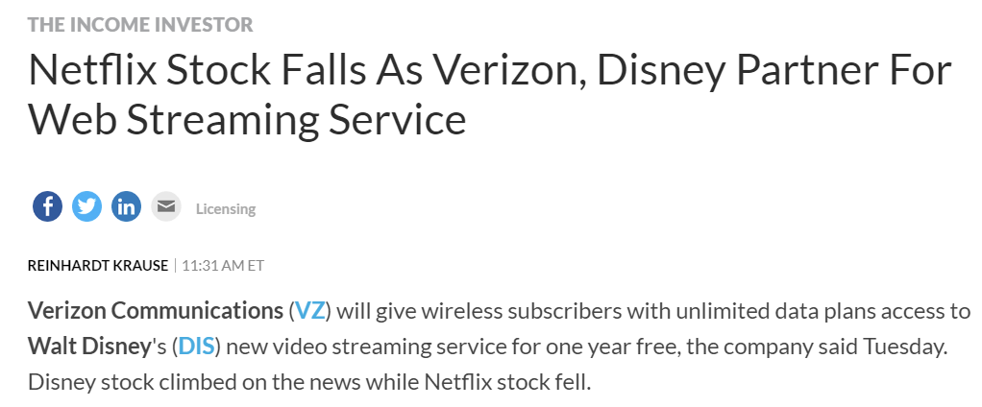
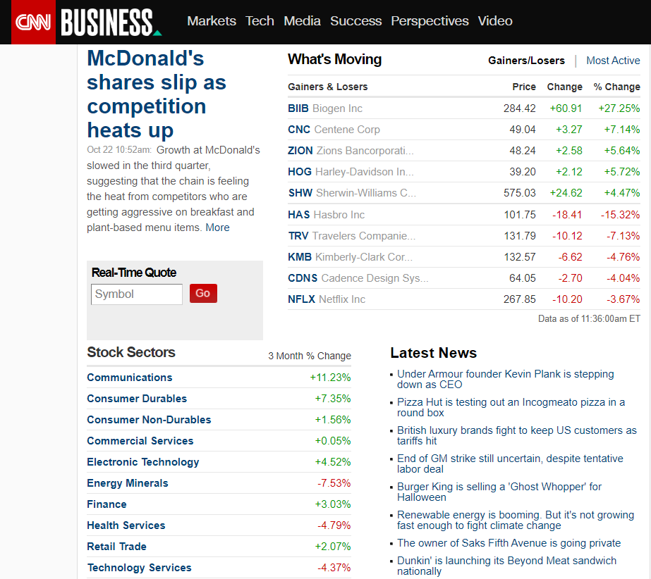
THE WHY FACTOR
STOCK MARKET IS VOLATILE AND DEPENDENT NOT ONLY ON THE TYPE OF INDUSTRY BUT ALSO ON THE DETAILS ABOUT THE COMPANY INVESTED OR ABOUT THE COMPETITION.
BOTH NEWS AND STOCK VALUE ARE REAL TIME DEPENDENT FACTORS.

Slide 3
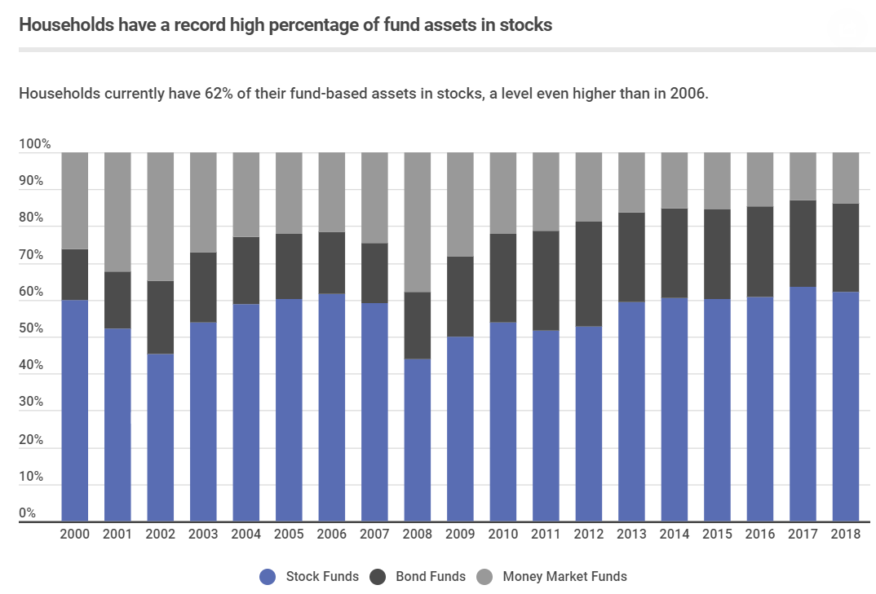
WHY IS IT IMPORTANT TO YOU
Stock Value
Demand and Supply
Basic Necessities
Additional Products and Services
Marketing
News & TV Channels
Social Media
Events

Slide 4
PREDICTION TARGET & DATA DESCRIPTION
2 Datasets : 1. Stock Value for a day (Features: Open, High, Low, Close & Adj Close
2. Reddit Top 25 News Headlines
News Headlines are Feature Engineered and extracted features from the text words are Subjectivity, Objectivity, Neutral, Positive and Negative percentages of words in the news.
Dataset Source: https://www.kaggle.com/lseiyjg/use-news-to-predict-stock-markets
Project Objective
binary classification task with two labels
"1" when DJIA Adj Close value rose or stayed as the same
"0" when DJIA Adj Close value decreased.
We are trying to Predict whether a stock’s Adj close value increased (or remained same) or decreased on a particular day based on the news using classification algorithms

Slide 5

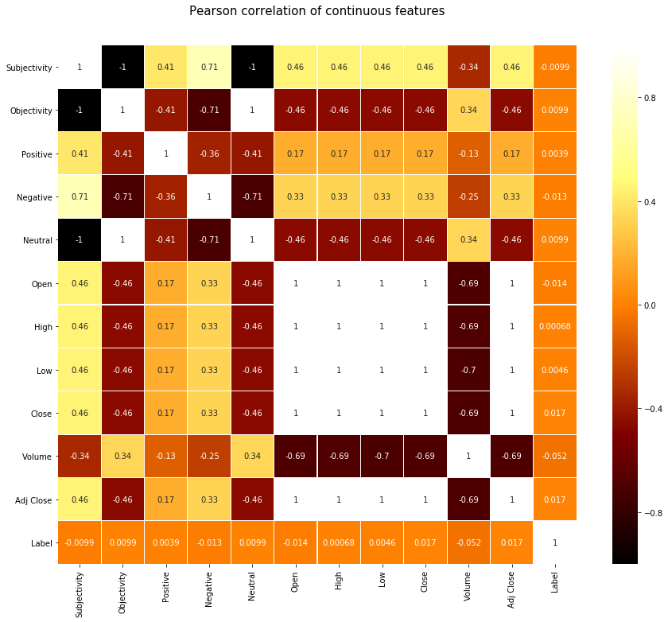



ANALYSIS STORY PART 1 THE FEATURES

Slide 6
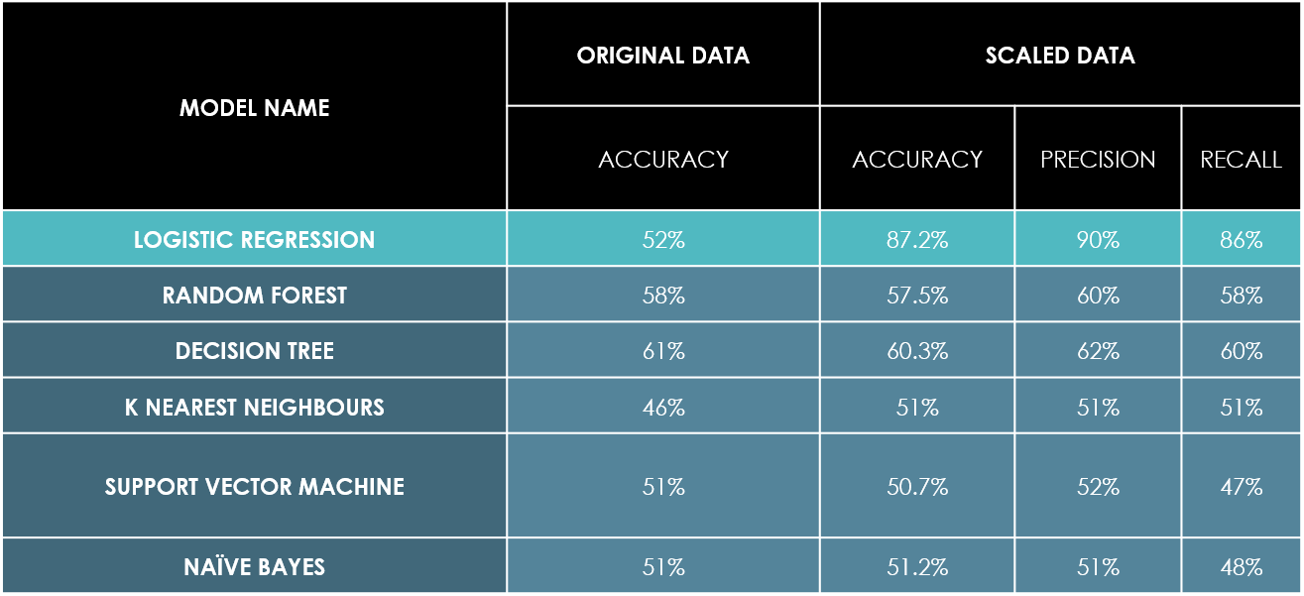
ANALYSIS STORY PART 2 THE MODELS

Slide 7
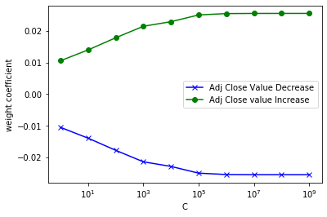
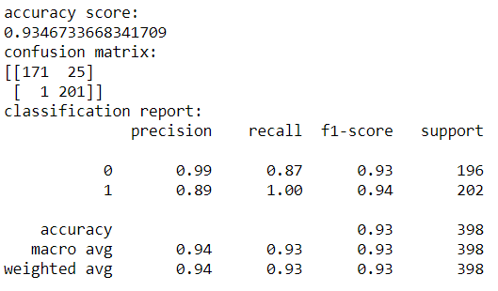
TUNING THE OPTIMUM MODEL LOGISTIC REGRESSION (L2 Regularization)

Slide 8
LONG TERM OBJECTIVES
In three months, I would like to figure out trends, seasonality in my given data set to understand stock movement based on time and perform a time series ARIMA model over the given data frame. By this analysis I can understand stock patterns in specific days of a week, specific months in a year and also perform outlier analytics during special case days such as product launch events, recession time period and so on.
In one year, I would like to extend the domain of analysis from only news headlines to including more features such as Social media trends like Twitter tweets, YouTube ads etc. , consider the companies own updates for better features as information channels in this digital era are not restricted only to news and the time series model as generated before to build a better robust model that can perform real time sentiment analysis and stock movement analysis.

Slide 9


REFERENCES
JAMES ELLIS (2019), American Households Have a Record Amount of Assets in Stocks, Retrieved from https://www.magnifymoney.com/blog/news/american-households-have-a-record-amount-of-assets-in-stocks/
REINHARDT KRAUSE (2019), Netflix Stock Falls As Verizon, Disney Partner For Web Streaming Service, Retrieved from https://www.investors.com/research/the-income-investor/netflix-stock-verizon-stock-disney-stock/
U.S STOCKS (Current), Retrieved from https://money.cnn.com/data/us_markets/index.html
BRIAN BEERS (2019), Why do stock prices change based on news reports? Retrieved from https://www.investopedia.com/ask/answers/155.asp

